Slide 1
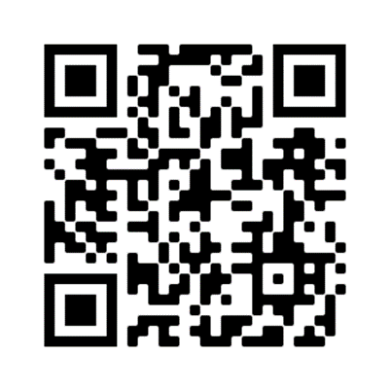
Important! You must check-in to receive credit in your training history
Three ways for you to check-in:
Click link in Chat Box provided by facilitator
Use QR code (open camera on your smart phone)
Open your browser and type in the web address below
https://mytraining.utsa.edu/apps/checkin
If you get an alert that you are not enrolled in the class, please let your facilitator know.
Enjoy your class!

Slide 2
Business Service Contracts
Policies and Procedures – AM541

Slide 3
Defining and assess what a business contract is
Describe and differentiate contract execution
Discuss and illustrate various types of business contracts
Review most commonly used business contracts at UTSA.
Classify and understand other types of business contracts
Identify a click-wrap contract
Evaluate an agreements with employees and its requirements
Define an after-the-fact agreement and review submission process
Analyze various contract routing methods
Detail using Total Contracts Manager
Identify and discuss contract timelines
Course Objectives
Defining and assess what a business contract is
Describe and differentiate contract execution
Discuss and illustrate various types of business contracts
Review most commonly used business contracts at UTSA.
Classify and understand other types of business contracts
Identify a click-wrap contract
Evaluate an agreements with employees and its requirements
Define an after-the-fact agreement and review submission process
Analyze various contract routing methods
Detail using Total Contracts Manager
Identify and discuss contract timelines
Business Contracts Office

Slide 4
Business Contracts Office Staff
Contracts Specialists
Contracts Administrator
Frank Grijalva, MBA (ext. 4975)
Todd Cheslock, J.D. (ext. 4899)
Nancy Wood, J.D. (ext. 4680)
Kelli Morrison (ext. 4065)
Management
Richard Wollney, J.D. (ext. 4069)
Robert Dickens, (ext. 4065)
Business Contracts Office

Slide 5
Defining a Contract
Contract Law 101
Business Contracts Office

Slide 6
A contract is an agreement between two parties that creates an obligation to perform (or not perform) a particular duty.
A legally enforceable contract requires:
An Offer (I’ll mow your lawn this weekend, if you pay me $30)
An Acceptance (You’ve got a deal)
Consideration (The value received and given – the money and the lawn mowed)
What is a Contract?
Contract Law 101 - Determining the Initial Step
Business Contracts Office

Slide 7
A legally recognized offer and an acceptance creates a “meeting of the minds’, or mutual assent, between the parties.
Mutual Assent requires the presence of the following factors:
Both parties must exhibit a “contractual intent” [words spoken in jest or frustration will lack the requisite intent];
The terms of the offer must be clear and definite;
The acceptance must be clearly communicated.
Establishing Offer and Acceptance:
“A Meeting of the Minds”
Business Contracts Office

Slide 8
Required Clarity: For terms to be legally valid, a reasonable person must be capable of readily understanding them.
Four primary areas in determining definite terms:
the parties;
time for performance (term or service schedule);
the price; and
the subject matter or scope of service.
The Requirement
Clear and Definite Terms
Business Contracts Office

Slide 9
“Bargained-for-Exchange”
Consideration must be mutual. Both parties must receive something of value.
Involvement of money is not required.
Consideration
The importance of the “Bargained Exchange”
Business Contracts Office

Slide 10
Executing the Contract
Who can Sign?
Business Contracts Office

Slide 11
President-Delegated Authority:
Only an individual with a written delegation of authority from the President of UTSA may execute and deliver contracts on behalf of the University. A University contract without an authorized signature may be invalid and unenforceable.
Currently, the President has delegated to the following positions the authority to sign business contracts:
Sr. Vice President for Business Affairs, up to $2.5 Million
Director of Business Contracts, up to $500K
Assoc. Director of Business Contracts, up to $250K
For UTSA’s full delegation listing, see https://www.utsystem.edu/documents/docs/general-counsel-documents/2016/delegation-of-authority-charts.
Signature
Authority
Who can sign?
Business Contracts Office

Slide 12
Types of Contracts
Various types of contracts
Business Contracts Office

Slide 13
Affiliation & International Program Agreements
Athletic-Specific, or Student-Specific Contracts (non- procurement in nature)
Entertainer/Artist Agreement
Interagency Cooperation Agreements (IAC) & Inter-Local Agreements
Museum/Exhibit Agreements
Revenue Generating Agreements
MOUs/MOAs
Participant/Speaker Agreement
Procurement Contracts; Vendor Services
Service Agreements (for individuals not organized as a business)
Click Wrap Agreements
Study Abroad Agreements
Software and/or Hosted License Agreements
Real Estate
Auxiliary Services
Business Contracts Office

Slide 14
Specific Business Contracts
More commonly used business contracts
Business Contracts Office

Slide 15
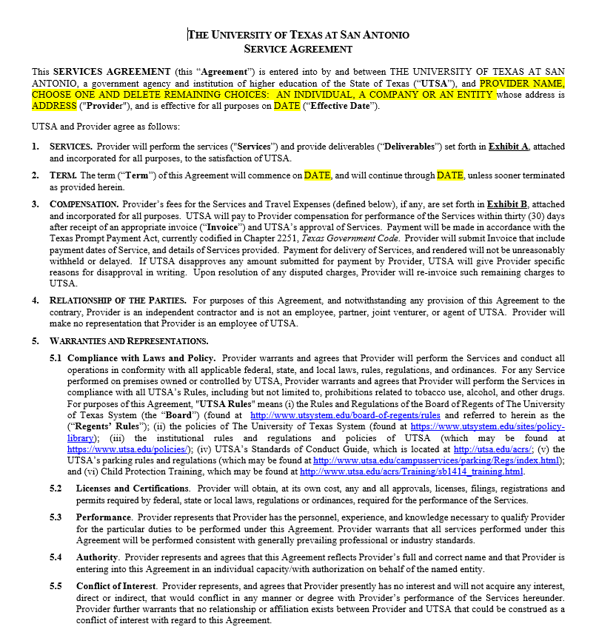
Service Agreement
Used for services from individuals or other entities not formally organized as a business
Small dollar: Total Value not to exceed $15,000 (including reimbursable expenses)
After the Fact Purchases (More detail to follow)
Details of Service Agreement (Critical Nature of Exhibits)
Business Contracts Office

Slide 16
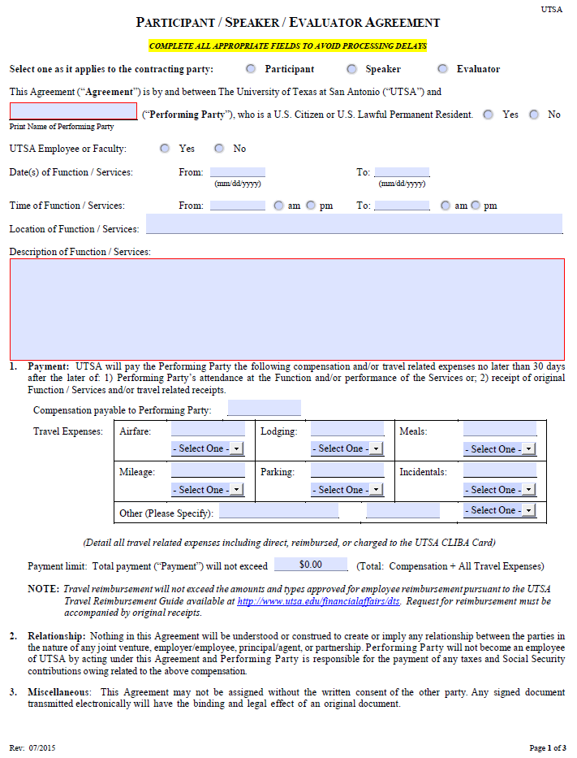
Participant, Speaker, Evaluator Agreement
Used for speakers, lecturers, evaluator, or to provide compensation to individuals participating in formal University events
Used to contract with individuals or other entities not formally organized as a business
Small dollar: Total Value not to exceed $15,000 (including reimbursable expenses)
Details of Participant/Speaker/Evaluator Agreement
Business Contracts Office

Slide 17
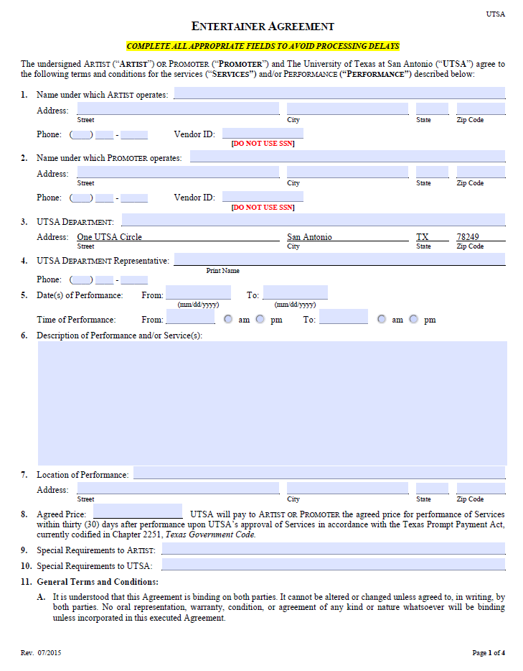
Entertainer, Artist, Promoter Agreement
Used for artists, entertainers, or performers
Used to contract with both individuals and companies
Exempt from Competitive Procurement: Value can exceed $15,000
Details of Entertainer/Artist Agreement
Business Contracts Office

Slide 18
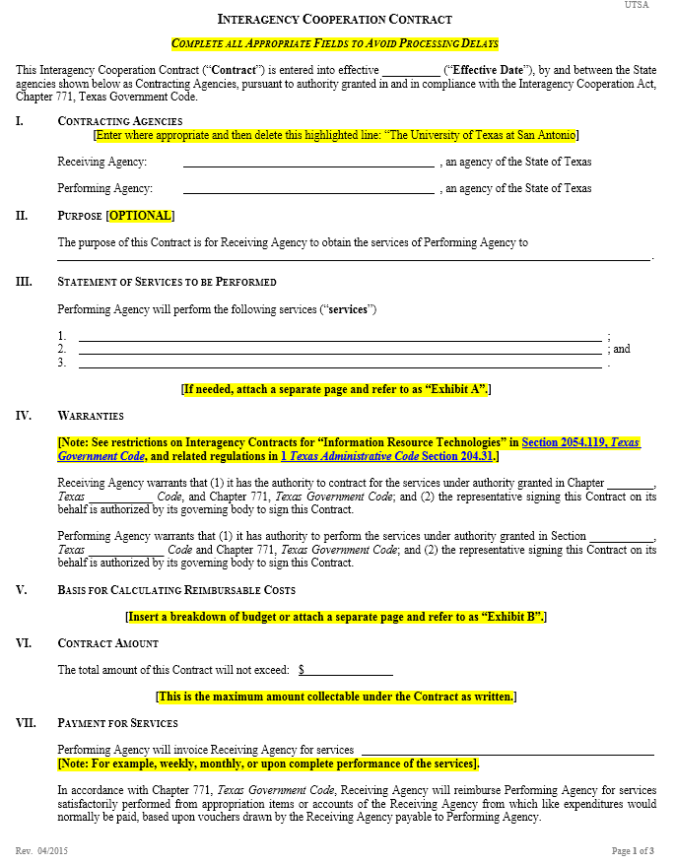
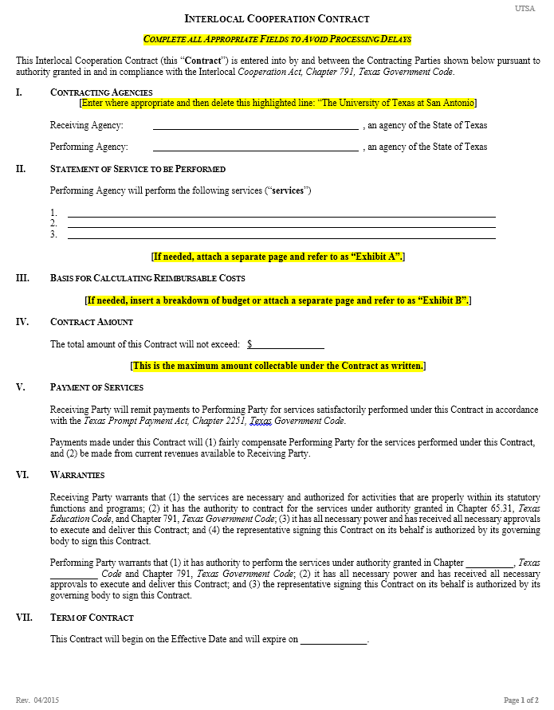
Interagency & Interlocal Agreements
Used for contracts with other State of Texas Government entities
Interagency: Contracts with other State agencies
Interlocal: Contracts with Texas municipal, county, and local government entities (also includes political subdivisions of the State, such as school districts)
Exempt from Competitive Procurement: Value can exceed $15,000 (with certain exceptions)
Business Contracts Office

Slide 19
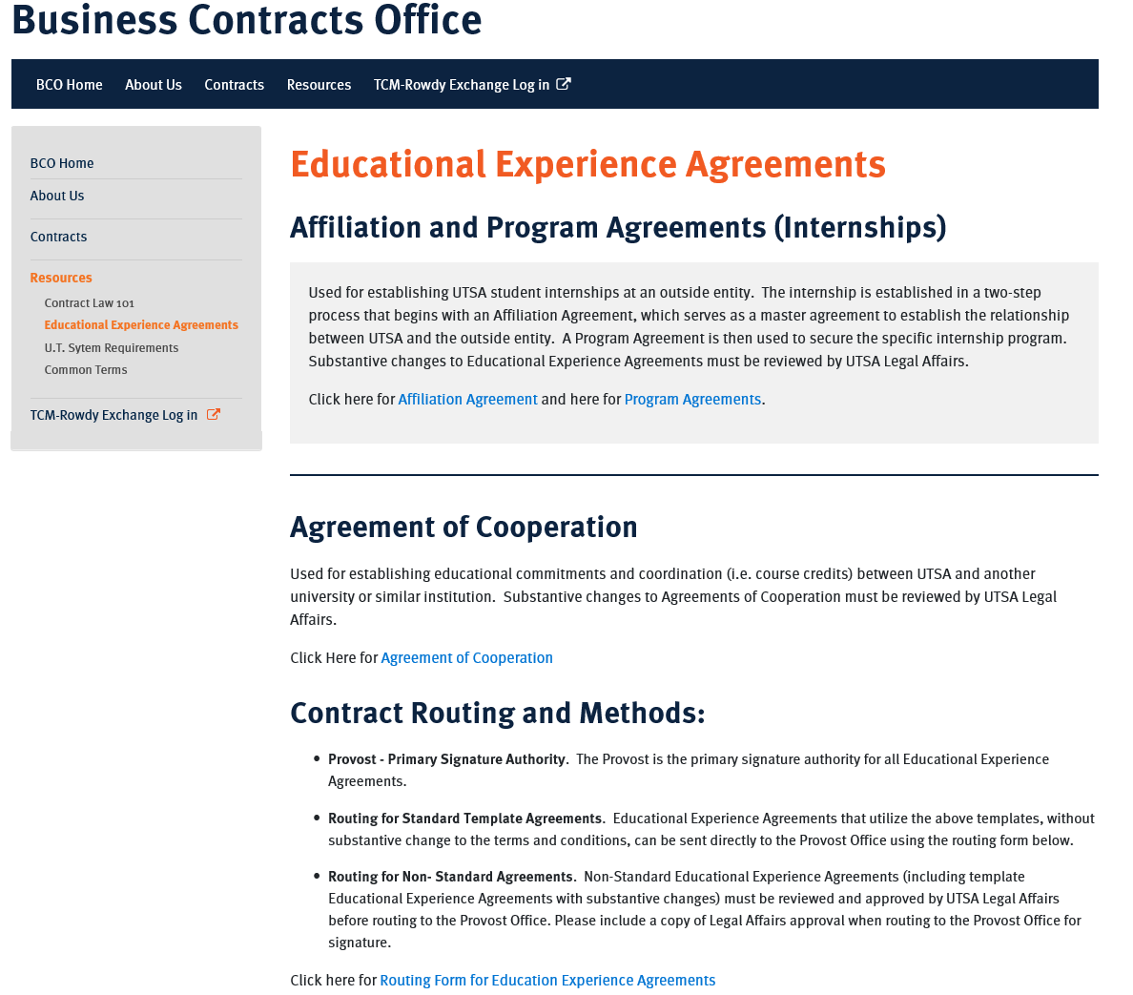
Educational Experience Agreements
Used to establish student internships
No exchange of funds
Changes to Standard Template Requires UT System Approval
Requires both Affiliation and Accompanying Program Agreement
Send Information Form to vendor
Business Contracts Office

Slide 20
Other Types of Business Contracts
Review specific contracts and their processes
Business Contracts Office

Slide 21
Clickwrap Agreements
“Clickwrap Agreements” are standard online terms and conditions displayed on the computer screen that require a purchaser to click “acceptance” before the user can secure the contractor’s goods or services.
Terms of Clickwrap Agreements are not advantageous to the University, do not address required terms based on UTSA’s status as a government agency and institution of UT System, and are generally not negotiable.
Efficiency needs may sometimes necessitate procuring goods or services involving a Clickwrap Agreement and based on various risk vs. efficiency factors, the University will permit certain limited use of Clickwrap Agreements in specific situations.
Business Contracts Office

Slide 22
Acceptable Use of Clickwrap for Low Risk Services
Low Risk Procurements Only. Low Risk Services with a contract term not to exceed one (1) year and a total contract value less than $5,000.
Certain Requirements and Limitations for Technology
Critical Accessibility Requirements for Technology (EIR).
HOP 8.22 Requirements of Use of Technology.
Low Risk Services Example. Low Risk Service involving software would be an annual Facebook account for University marketing purposes that only includes Category III Data (non-sensitive, non-confidential data that is generally public record).
Business Contracts Office

Slide 23
Higher Risk Procurements Prohibited
Category I or Category II Data (sensitive or confidential data, such as FERPA-related data).
unsupervised interaction to students or any reasonable risks to students;
interaction with minors;
safety, health, or medical matters;
risk to UTSA property;
access to UTSA’s network;
solicitation on campus;
providing any intellectual property of UTSA, or any other aspects related to copyright or publication rights, or related to UTSA;
modifications to UTSA property;
use of UTSA property by another entity;
required use of the service by students;
processing, collection, or storage of UTSA funds (ex: payment processer or reseller);
the vendor/contractor is a non-U.S. entity or individual;
providing the contracted entity with use of any UTSA trademarks, logos or related marks; or
any other aspect or service that could reasonably be determined to signify a significant risk to UTSA or the UTSA community.
Higher Risk Services must not be secured through Clickwrap and must be secured through either a purchase order or a negotiated agreement approved by the Business Contracts Office.
Business Contracts Office

Slide 24
Delegated Authority; Contract Validity
Reminder - Only an individual with a written delegation of signature authority may execute contracts on behalf of UTSA.
If the requesting department desires to ensure validity of an applicable Low Risk Service Clickwrap Agreement secured via the One Card, the Clickwrap Agreement cannot be utilized.
The Clickwrap Agreement will need to be secured through either a purchase order or a negotiated agreement approved by the Business Contracts Office.
Business Contracts Office

Slide 25
Business and Legal Risks
Clickwrap Agreements are typically one-sided and drafted solely to the contractor’s benefit, any Clickwrap Agreement can come with business risks.
Departments procuring Low Risk Services involving a Clickwrap Agreement must understand the scope of the purchase, and must accept the possible business risks, including paying for any damages and legal costs which may occur because of the purchase.
Business Contracts Office

Slide 26
Handbook of Operating Procedures 1.33 Conflict of Interest, Conflict of Commitment, and Outside Activities
Self-dealing/Transactions with Employees
Requires President’s Approval
Cost less than from any other known source
Agreements with Employees
What you need to know
Business Contracts Office

Slide 27
ALL Agreements with Employees requests should be forwarded to the Business Contracts Office for review.
The Business Contracts Office will advise the department on the required steps in securing the appropriate approvals for an Agreement with an Employee and how to document it with the required offices.
Agreements with Employees
How to process
Business Contracts Office

Slide 28
What is an After-the-Fact?
Services or Goods Secured Prior to an Executed Contract (includes PO)
Purchasing’s After-the-Fact Form found under Procurement Forms in Rowdy Exchange’s Shopping Dashboard
Fill out and follow steps outlined in form for all After-the-Fact purchases
After-the-fact
What you need to know
Business Contracts Office

Slide 29
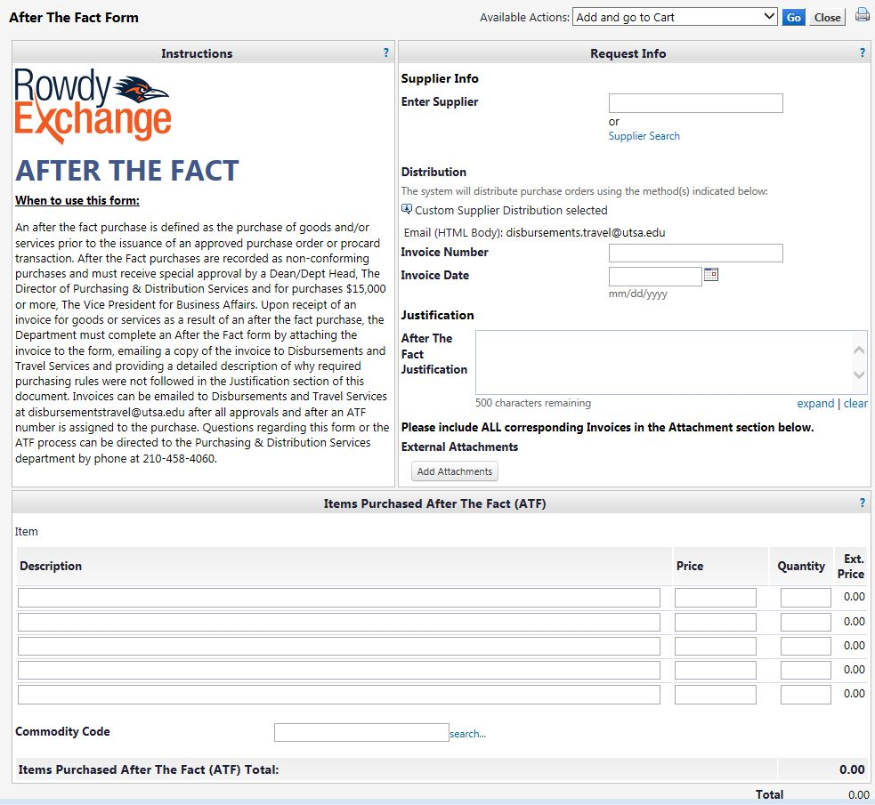
After-the-fact
Business Contracts Office

Slide 30
Contract Routing Methods
Using SciQuest TCM and other routing methods
Business Contracts Office

Slide 31
The Business Contracts Office can receive an agreement utilizing the method below:
Electronic Submission through Rowdy Exchange's Total Contracts Manager (TCM)
For more details on routing an agreement, see http://www.utsa.edu/bco/contracts/submitting.html
Contract Routing Methods
What you need to know
Business Contracts Office

Slide 32
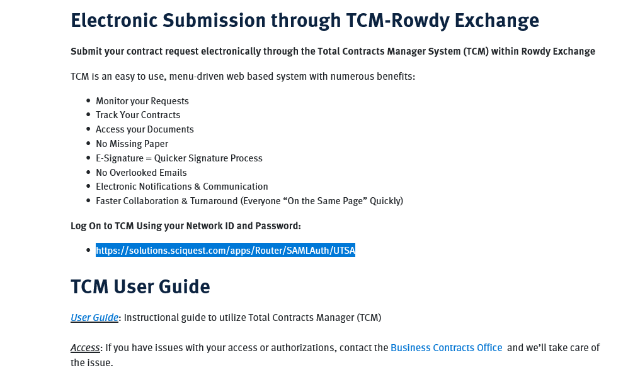
Routing using Total Contracts Manager (TCM)
Submit you contract requests and monitor them electronically
Easy upload of contract documents and required approvals
Access your department’s contracts and search all business agreements processed by the University
Single Sign-On (abc123)
https://solutions.sciquest.com/apps/Router/SAMLAuth/UTSA
Business Contracts Office

Slide 33
Contract Timelines
How long will it take to complete?
Business Contracts Office

Slide 34
Standard Template Agreements with all routing secured are typically signed within 3 business days upon receipt by the Business Contracts Office
Delays Resulting from Improper Routing, Incorrect Information Provided, and/or Incorrect Attachments
Agreements with Substantive Modifications need to reviewed by the Business Contracts Office
General Timelines
What you should know.
Business Contracts Office

Slide 35
Additional Information
Business Contracts Website
Business Contracts Office

Slide 36
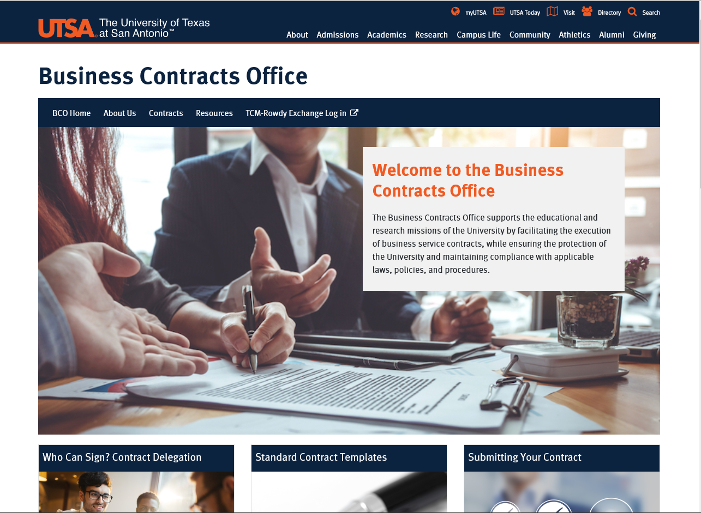
BCO Website
Quick tour of links and valuable information
Business Contracts Office

Slide 37
Questions?
Business Contracts Office

Slide 38
Thank You
Business Contracts Office

Slide 39
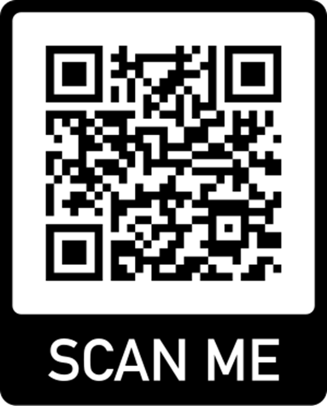
Thank you for attending class Please complete the electronic evaluation form
Go to: https://mytraining.utsa.edu/apps/evaluations
Click ‘Load classes’ (orange tab)
Click the name of the class you took today
Click ‘Start Evaluation’
Click ‘Give Feedback’
IMPORTANT ‘1’ is LOW and ‘7’ is HIGH
Please add your comments in the open comment box at the end
Business Contracts Office

